Slide 1
Discrete Mathematics and Logic (UE18CS205)
Unit 4 - Induction, Recursion and Recurrence Relations
Mr. Channa Bankapur Ms.Sangeeta V I
Department of CS&E, PES University
‹#›

Slide 2
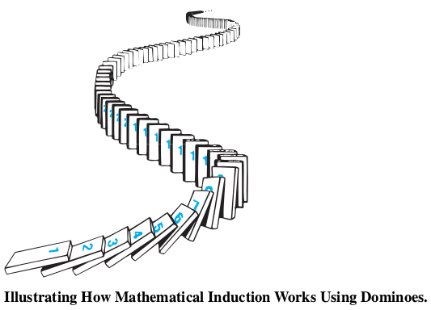
Mathematical Induction

Slide 3
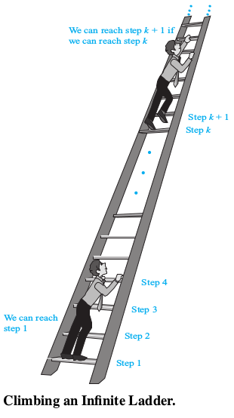
Mathematical Induction
Suppose that we have an infinite ladder and we want to know whether we can reach every step on this ladder. We know two things:
We can reach the first step of the ladder.
If we can reach a particular step of the ladder, then we can reach the next step.
Can we conclude that we can reach every step?

Slide 4
Mathematical Induction
By (1), we know that we can reach the first
step of the ladder. By (2), we can also reach the
second step because we can reach the first step. Applying (2) again, we can also reach the third step because we can reach the second step. Continuing in this way, we can show that we can reach the fourth step, the fifth step, and so on. But can we conclude that we are able to reach every step of this infinite ladder? The answer is yes, something we can verify using an important proof technique called mathematical induction.
That is, we can show that P(n) is true for every positive integer n, where P(n) is the statement that we can reach the n^{th} step of the ladder.

Slide 5
Principle of Mathematical Induction:
To prove that P(n) is true for all positive integers n, where P(n) is a propositional function, we complete two steps:
Basis Step: We verify that P (1) is true.
Inductive Step: We show that the conditional statement P(k) → P(k+1) is true for all positive integers k.
Expressed as a rule of inference, this proof technique can be stated as
(P(1) ∧ ∀k (P(k) → P(k+1))) → ∀n P(n),
when the domain is the set of positive integers.

Slide 6
Why is mathematical induction a valid proof technique? The well-ordering property as an axiom for the set of +ve integers states that every nonempty subset of the set of +ve integers has a least element. So, suppose we know that P(1) is true and P(k) → P(k+1) is true for all +ve integers k. To show that P(n) must be true for all +ve integers n, assume that there is at least one +ve integer for which P(n) is false. Then the set S of +ve integers for which P(n) is false is nonempty. Thus, by the well-ordering property, S has a least element, which will be denoted by m. We know that m cannot be 1, because P(1) is true. Because m is +ve and greater than 1, m−1 is a +ve integer. Furthermore, because m−1 is less than m, it is not in S, so P (m−1) must be true. Because the conditional statement P(m−1) → P(m) is also true, it must be the case that P(m) is true. This contradicts the choice of m. Hence, P(n) must be true for every positive integer n.

Slide 7
Eg: Show that if n is a positive integer, then
1 + 2 + ··· + n = n(n+1)/2
Let P(n) be the proposition that the sum of the first n positive integers, 1 + 2 + · · · n = n(n+1)/2.
We must do two things to prove that P(n) is true.
Namely, we must show that P(1) is true and that the conditional statement P(k) implies P(k+1) is true for k = 1, 2, 3, … .
BASIS STEP: P (1) is true, because 1 = 1(1+1)/2.
INDUCTIVE STEP: For the inductive hypothesis we assume that P(k) holds for an arbitrary positive integer k. That is, we assume that 1 + 2 + ··· + k = k(k+1)/2.

Slide 8
Eg: Show that if n is a positive integer, then
1 + 2 + ··· + n = n(n+1)/2
…
Under this assumption, it must be shown that P(k+1) is true, namely, that
1 + 2 + · · · + k + (k + 1) = (k + 1)(k + 2)/2 is true.
When we add k + 1 to both sides of the equation in P(k), we obtain
1 + 2 + · · · + k + (k + 1) = k(k+1)/2 + (k + 1)
= (k(k+1)+(2k+2)) / 2
= (k+1)(k+2)/2
It shows that P(k+1) is true under the assumption that P(k) is true. This completes the inductive step.
So by mathematical induction we know that P(n) is true for all positive integers n.

Slide 9
Eg: Conjecture a formula for the sum of the first n positive odd integers. Then prove your conjecture using mathematical induction.

Slide 10
Eg: Conjecture a formula for the sum of the first n positive odd integers. Then prove your conjecture using mathematical induction.
Conjecture:
Sum of the first n positive odd integers is n².
1 + 3 + 5 + … + (2n-1) = n²

Slide 11
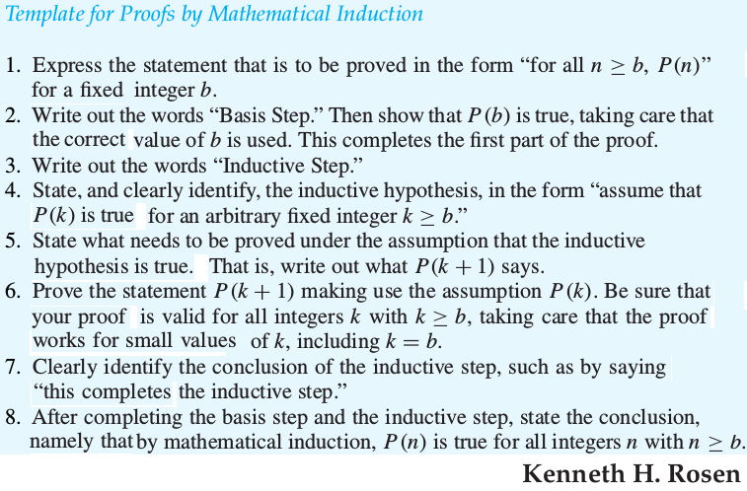

Slide 12
Eg: Use mathematical induction to show that
1 + 2 + 2² + · · · + 2^{n} = 2^{n+1} − 1
for all nonnegative integers n.

Slide 13

Eg: Sums of Geometric Progressions Use mathematical induction to prove this formula for the sum of a finite number of terms of a geometric progression with initial term a and common ratio r:
where n is a nonnegative integer.

Slide 14
Eg: Use mathematical induction to prove the inequality n < 2^{n} for all positive integers n.

Slide 15
Eg: Use mathematical induction to prove that 2^{n} < n! for every integer n with n ≥ 4. (Note that this inequality is false for n = 1, 2, and 3.)

Slide 16
Eg: Use mathematical induction to prove that n³−n is divisible by 3 whenever n is a positive integer.

Slide 17
Eg: Use mathematical induction to prove that 7^{n+2} + 8^{2n+1} is divisible by 57 for every nonnegative integer n.

Slide 18
Eg: The Number of Subsets of a Finite Set
Use mathematical induction to show that if S is a finite set with n elements, where n is a nonnegative integer, then S has 2^{n} subsets.

Slide 19
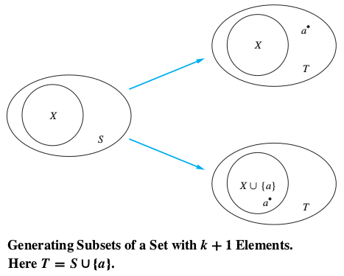
Eg: The Number of Subsets of a Finite Set
Use mathematical induction to show that if S is a finite set with n elements, where n is a nonnegative integer, then S has 2^{n} subsets.

Slide 20
[OPTIONAL] Eg: The input to a scheduling algorithm is a group of m proposed talks with preset starting and ending times. The goal is to schedule as many of these lectures as possible in the main lecture hall so that no two talks overlap. Suppose that talk t_{j} begins at time s_{j} and ends at time e_{j}. (No two lectures can proceed in the main lecture hall at the same time, but a lecture in this hall can begin at the same time another one ends.)

Slide 21
Eg: … scheduling algorithm …
Sort the talks in nondecreasing order of their ending times: e₁ ≤ e₂ ≤ … ≤ e_{m}.
The greedy algorithm starts by selecting a talk with the earliest end time and then proceeds by selecting at each stage a talk with the earliest ending time among all those talks that begin no sooner than when the last talk scheduled in the main lecture hall has ended. Using mathematical induction, show that this greedy algorithm is optimal in the sense that it always schedules the most talks possible in the main lecture hall.

Slide 22
Eg: … scheduling algorithm …
Let P(n) be the proposition that if the greedy algorithm schedules n talks in the main lecture hall, then it is not possible to schedule more than n talks
in this hall.
BASIS STEP: Suppose that the greedy algorithm managed to schedule just one talk, t₁ , in the main lecture hall. Every pair of talks are overlapping and hence only one talk can be scheduled.
INDUCTIVE STEP: The inductive hypothesis is that P(k) is true that the greedy algorithm always schedules the most possible talks when it selects k talks given any set of talks.

Slide 23
Eg: … scheduling algorithm …
We must show that P(k+1) follows from the assumption that P(k) is true, that is, we must show that under the assumption of P(k), the greedy algorithm always schedules the most possible talks when it selects k+1 talks.
Our first step in completing the inductive step is to show there is a schedule including the most talks possible that contains talk t1, a talk with the earliest end time. It’s easier to show t1 is in at least one of the schedules having k+1 talks, and it’s the first task in the schedule. A schedule that begins with the talk ti in the list, where i>1, can be changed so that talk t1 replaces talk ti. To see this, note that because e1≤ei, all talks that were scheduled to follow talk ti can still be scheduled.

Slide 24
Eg: … scheduling algorithm …
Once we included talk t1, scheduling the talks so that as many as possible are scheduled is reduced to scheduling as many talks as possible that begin at or after time e1. Because the greedy algorithm schedules k talks when it creates this schedule, we can apply the inductive hypothesis to conclude that it has scheduled the most possible talks. So P(k+1) is true.
So, by mathematical induction we know that P(n) is true for all positive integers n. That is, we have proved that when the greedy algorithm schedules n talks, when n is a positive integer, then it is not possible to schedule more than n talks.

Slide 25
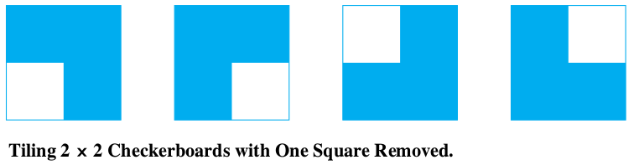
[OPTIONAL] Eg: Let n be a positive integer. Show that every 2^{n} × 2^{n} checkerboard with one square removed can be tiled using right triominoes, where these pieces cover three squares at a time, as shown in the figure.
Solution: Let P(n) be the proposition that every 2^{n}×2^{n} checkerboard with one square removed can be tiled using right triominoes.
BASIS STEP: P(1) is true, because each of the four 2¹×2¹ checkerboards with one square removed can be tiled using one right triomino, as shown in the figure.

Slide 26
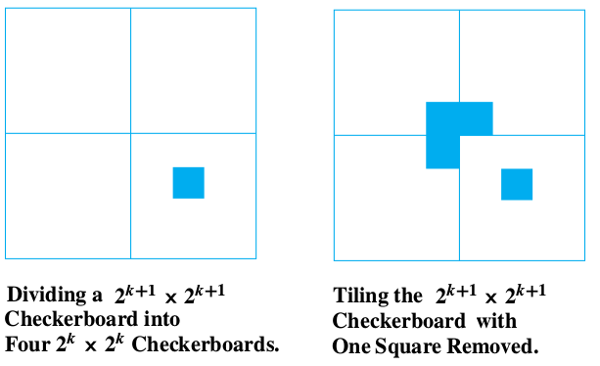

Slide 27
Strong Induction:
To prove that P(n) is true for all positive integers n, where P(n) is a propositional function, we complete two steps:
BASIS STEP:
We verify that the proposition P(1) is true.
INDUCTIVE STEP:
We show that the conditional statement
[P(1) ∧ P(2) ∧ · · · ∧ P(k)] → P(k+1)
is true for all positive integers k.

Slide 28
Note that when we use strong induction to prove that P(n) is true for all positive integers n, our inductive hypothesis is the assumption that P(j) is true for j = 1, 2, …, k. That is, the inductive hypothesis includes all k statements P(1), P(2), . . . , P(k). Because we can use all k statements P(1), P(2), . . . , P(k) to prove P(k+1), rather than just the statement P(k) as in a proof by mathematical induction, strong induction is a more flexible proof technique.
Mathematical induction and strong induction are equivalent. That is, each can be shown to be a valid proof technique assuming that the other is valid. In
particular, any proof using mathematical induction can also be considered to be a proof by strong induction.

Slide 29
Eg: Suppose we can reach the first and second steps of an infinite ladder, and we know that if we can reach a step, then we can reach two steps higher. Prove that we can reach every step using strong induction?
BASIS STEP: It simply verifies that we can reach the first two steps.
INDUCTIVE STEP: The inductive hypothesis states that we can reach each of the first k steps. We can complete the inductive step by noting that as long as k ≥ 2, we can reach the (k+1)^{st} step from the (k−1)^{st} step because we know we can climb two steps from a step we can already reach, and because k−1 ≤ k, by the inductive hypothesis we can reach the (k−1)^{st} step. This completes the inductive step and finishes the proof by strong induction.

Slide 30
Eg: Show that if n is an integer greater than 1, then n can be written as the product of primes.
Let P(n) be the proposition that …
BASIS STEP: …
INDUCTIVE STEP: …

Slide 31
Eg: Show that if n is an integer greater than 1, then n can be written as the product of primes.
Let P(n) be the proposition that n can be written as the product of primes.
BASIS STEP: P(2) is true, because 2 can be written as the product of one prime, itself.
INDUCTIVE STEP: The inductive hypothesis is the assumption that P(j) is true for all integers j with 2≤j≤k. To complete the inductive step, it must be shown that P(k+1) is true under this assumption.
There are two cases to consider, namely, when k+1 is prime and when k+1 is composite.

Slide 32
If k+1 is prime, we immediately see that P(k+1) is true. Otherwise, k+1 is composite and can be written as the product of two positive integers a and b with 2 ≤ a ≤ b < k+1. Because both a and b are integers at least 2 and not exceeding k, we can use the inductive hypothesis to write both a and b as the product of primes. Thus, if k+1 is composite, it can be written as the product of primes, namely, those primes in the factorization of a and those in the factorization of b.

Slide 33
Eg: Consider a game in which two players take turns removing any positive number of matches they want from one of two piles of matches. The player who removes the last match wins the game. Show that if the two piles contain the same number of matches initially, the second player can always guarantee a win.
Solution: Let n be the number of matches in each pile, initially. Let P(n) be the propositional function that the second player can win when there are initially n matches in each pile.
BASIS STEP: …
INDUCTIVE STEP: …

Slide 34
Eg: Prove that every amount of bus ticket of ₹12 or more can be formed using just ₹4 and ₹5 tickets.
Solution: Let P(n) be the propositional function that a bus ticket of ₹ n can be formed using ₹4 and ₹5 tickets.
BASIS STEP: …
INDUCTIVE STEP: …

Slide 35
Recursion is the process of defining an object in terms of itself.
Recursively Defined Functions
We use two steps to define a function with the set of nonnegative integers as its domain:
BASIS STEP: Specify the value of the function at zero.
RECURSIVE STEP: Give a rule for finding
its value at an integer from
its values at smaller integers.
Eg: Recursive definition of sum of first n natural numbers.
BASIS STEP: f(0) = 0.
RECURSIVE STEP: f(n) = f(n-1) + n.

Slide 36
Eg: Fibonacci numbers, f₀, f₁, f₂, . . . , are defined by
BASIS STEP: f₀ = 0, f₁ = 1.
RECURSIVE STEP: f_{n} = f_{n-1} + f_{n-2} .
Eg: Give a recursive definition of a^{n}, where a is a nonzero real number and n is a nonnegative integer.

Slide 37

Eg: Give a recursive definition of a^{n}, where a is a nonzero real number and n is a nonnegative integer.
BASIS STEP: a⁰ = 1.
RECURSIVE STEP: a^{n} = a * a^{n-1}.
Eg: Give a recursive definition of

Slide 38
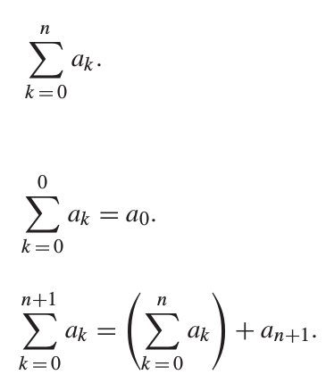
Eg: Give a recursive definition of
BASIS STEP:
RECURSIVE STEP:

Slide 39
Recursive algorithms
An algorithm is called recursive if it solves a problem by reducing it to an instance of the same problem with smaller input.
Eg: Give a recursive definition and recursive algorithm for computing n!, where n is a nonnegative integer.
Recursive definition: 0! = 1 and n! = n * (n-1)!
procedure factorial(n: nonnegative integer)
if n = 0 then return 1
else return n * factorial(n−1)

Slide 40
Eg: Give a recursive definition and a recursive algorithm for computing the greatest common divisor of two nonnegative integers a and b with b < a using Euclid’s theorem on GCD.
Recursive definition:
gcd(a, 0) = a, and
gcd(a, b) = gcd(b, a mod b)
procedure gcd(a, b: nonnegative integers)
if b = 0 then return a
else return gcd(b, a mod b)

Slide 41
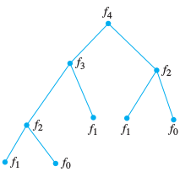
Eg: Give a recursive definition and a recursive algorithm for finding n^{th} number in the fibonacci sequence.
Recursive definition:
f(0) = 0, f(1) = 1, and
f(n) = f(n-1) + f(n-2).
procedure f(n: nonnegative
integer)
if n = 0 then return 0
else if n = 1 then return 1
else return f(n-1) + f(n-2)

Slide 42
Recurrence Relations
A recurrence relation for the sequence {a_{n}} is an equation that expresses a_{n} in terms of one or more of the previous terms of the sequence, namely, a_{n0}, a_{n1}, …, a_{n-1}, for all integers n with n ≥ n₀, where n₀ is a nonnegative integer.
A sequence is called a solution of a recurrence relation if its terms satisfy the recurrence relation.

Slide 43
Eg: Let {a_{n}} be a sequence that satisfies the recurrence relation a_{n} = a_{n-1} - a_{n-2} for n = 2, 3, …, and suppose that a₀ = 3 and a₁ = 5. What are a₂ and a₅?
Solution:
a₂ = 5 - 3 = 2
a₃ = 2 - 5 = -3
a₄ = -3 - 2 = -5
a₅ = -5 - (-3) = -2

Slide 44
Eg: Determine whether the sequence {a_{n}}, where a_{n} = 3n for every nonnegative integer n, is a solution of the recurrence relation a_{n} = 2a_{n-1} - a_{n-2} for n = 2, 3, 4, …. Answer the same question where
(b) a_{n} = 2^{n} and
(c) a_{n} = 5.
Solution: True because 2(3(n-1))-3(n-2) = 3n
(b) False because 2(2^{n-1})-2^{n-2} = 2^{n} is false.
(c) True because 2(5) - 5 = 5.

Slide 45
Fibonacci numbers:
f_{n} = f_{n-1} + f_{n-2}, where f₀ = 0 and f₁ = 1.
Eg: Find a recurrence relation and give initial conditions for the number of bit strings of length n that do not have two consecutive 0s. How many such bit strings are there of length eight.
Solution: …

Slide 46
Eg: Find a recurrence relation and give initial conditions for the number of bit strings of length n that do not have two consecutive 0s. How many such bit strings are there of length eight.
Solution: a_{n} = a_{n-1} + a_{n-2}, where a₁ = 2 and a₂ = 3.
2, 3, 5, 8, 13, 21, 34, 55.
55 bit strings of length 8 don’t have 2 consecutive 0s.

Slide 47
The Tower of Hanoi puzzle:
Move n disks from peg A to peg B using peg C.
Move top n-1 disk from peg A to C.
Move disk# n from peg A to B.
Move n-1 disks from peg C to B
# of moves, H_{n}=2H_{n-1}+1 with the initial condition H₁=1.
Power(x, y) = x * Power(x, y-1), where x∈R, y∈Z⁺
with the initial condition Power(x, 0) = 1.
Factorial(n) = n * Factorial(n-1), where n∈Z⁺ and Factorial(0) = 1.

Slide 48
Eg: Suppose that a person deposits Rs. 10,000 in a savings account at a bank yielding 11% per annum with interest compounded annually. How much will be in the account after 30 years?
P_{n} = 1.11 * P_{n-1}, P₀ = ₹10,000
P₃₀ = ₹228,922

Slide 49
Q: Find the solution (closed form) of a_{n} = 2a_{n-1}
where a₀ = 3
Soln: By substitution
a_{n} = 2a_{n-1} where a₀ = 3
a_{n} = 2a_{n-1}
= 2(2a_{n-2}) = 2²a_{n-2}
= 2²(2a_{n-3}) = 2³a_{n-3}
= 2^{i} a_{n-i}
When n-i=0, i=n
= 2^{n} a₀
= 3*2^{n}

Slide 50
Solving Recurrence Relations
Finding solution to a recurrence relation means finding “closed form expressions” equivalent to the recurrence because it is as good as generating the sequence and find n^{th} term directly without finding the previous terms.
Q: Solve a_{n} = a_{n-1} + C, where a₀ is a constant
Solution: a_{n} = C*n + a₀
Q: Solve a_{n} = Ca_{n-1}, where a₀ is a constant
Solution: a_{n} = C^{n} * a₀

Slide 51
Q: Find the solution (closed form) of a_{n} = 3a_{n-1}
where a₀ = 5
Soln: This is a known form.
The solution of a_{n} = Ca_{n-1} would be a₀ * C^{n}
Therefore, solution of a_{n} = 2a_{n-1} is 5 * 3^{n}

Slide 52
Solving Linear Homogeneous Recurrence Relations with Constant Coefficients
Linear homogeneous recurrence relation of degree k with constant coefficients is a recurrence relation of the form:
a_{n} = c₁a_{n-1} + c₂a_{n-2} + ... + c_{k}a_{n-k}
where c₁, c₂, c₃, ..., c_{k} are reals and c_{k} ≠ 0.

Slide 53
Linear Homogeneous Recurrence Relations with Constant Coefficients
a_{n} = c₁a_{n-1} + c₂a_{n-2} + ... + c_{k}a_{n-k}
a_{n} = 2a_{n-1} + 3 is not homogeneous (not all terms has a factor a_{j})
a_{n} = na_{n-1} coefficient not constant
a_{n} = 3a²_{n-1} is not linear
a_{n} = a_{n-1} + a_{n-2} is of degree 2
a_{n} = 4a_{n-2} is of degree 2
a_{n} = 3a_{n-5} - 4a_{n-2} is of degree 5

Slide 54
Linear Homogenous Recurrence Relation with constant coefficients occur often in modeling problems and can be systematically solved.
Theorem 1 - For degree 2 and distinct roots r₁ and r₂
{a_{n}} is a solution of a_{n} = c₁a_{n-1} + c₂a_{n-2}
iff a_{n} = α₁r₁^{n} + α₂r₂^{n} for n = 0, 1, 2, ...,
where r² - c₁r - c₂ = 0 has two distinct roots r₁ and r₂,
with constants α₁ and α₂.

Slide 55
Theorem 1: {a_{n}} is a solution of a_{n} = c₁a_{n-1} + c₂a_{n-2}
iff a_{n} = α₁r₁^{n} + α₂r₂^{n} for n = 0, 1, 2, ...,
where r² - c₁r - c₂ = 0 has two distinct roots r₁ and r₂,
with constants α₁ and α₂
Recurrence: a_{n} = c₁a_{n-1} + c₂a_{n-2}
Characteristic equation: r² - c₁r - c₂ = 0
Characteristic roots: r₁ and r₂ (distinct roots)
Solution for the recurrence: a_{n} = α₁r₁^{n} + α₂r₂^{n} for n = 0,1,2,...,
Constants: α₁ and α₁ are constants, which can be
found using initial conditions a₀ and a₁.

Slide 56
Q: What is the solution (closed form) of
a_{n} = a_{n-1}+ 2a_{n-2} where a₀ = 2, a₁ = 7
Soln: c₁= 1, c₂ = 2
r² - c₁r - c₂ = 0 is the characteristic equation
r² - r - 2 = (r+1)(r-2) = 0
r₁ = 2, r₂ = -1 are the characteristic roots
Using initial conditions and roots, solve
a_{n} = α₁r₁^{n} + α₂r₂^{n} for α₁ and α₂
a_{n} = α₁2^{n} + α₂(-1)^{n}

Slide 57
a_{n} = α₁2^{n} + α₂(-1)^{n}
for constants α₁ and α₂
a₀ = 2
= α₁r₁⁰ + α₂r₂⁰ = α₁2⁰ + α₂(-1)⁰
= α₁ + α₂
α₁ + α₂ = 2
a₁ = 7
= α₁r₁¹ + α₂r₂¹ = α₁2¹ + α₂(-1)¹
= 2α₁ - α₂
2α₁ - α₂ = 7

Slide 58
Solving simultaneous equations
α₁ + α₂ = 2
2α₁ - α₂ = 7
α₁ =3, α₂ = -1
a_{n} = α₁2^{n} + α₂(-1)^{n}
a_{n} = 3*2^{n} + (-1)^{n+1}
is the solution (closed form) for
a_{n} = a_{n-1}+ 2a_{n-2} where a₀ = 2, a₁ = 7

Slide 59
Q: Find the solution (closed form) of a_{n} = 7a_{n-1} - 10a_{n-2}
where a₀ = 2, a₁ = 1
Soln: …

Slide 60
Q: Find the solution (closed form) of f_{n} = f_{n-1} + f_{n-2}
where f₀ = 0, f₁ = 1
Soln: …

Slide 61
Q: What is the solution (closed form) of
a_{n} = 6a_{n-1}- 9a_{n-2} where a₀ = 1, a₁ = 6
Soln: c₁= 6, c₂ = -9
r² - 6r + 9 = (r-3)(r-3) = 0
r₁ = 3, r₂ = 3
but the roots are not distinct…

Slide 62
Theorem 2 - For degree 2 and 1 root (multiplicity 2)
{a_{n}} is a solution of a_{n} = c₁a_{n-1} + c₂a_{n-2}
iff a_{n} = α₁r₀^{n} + α₂nr₀^{n} for n=0,1,2,...,
where r² - c₁r - c₂ = 0 has one root r₀,
with constants α₁ and α₂.

Slide 63
Q: What is the solution (closed form) of
a_{n} = 6a_{n-1}- 9a_{n-2} where a₀ = 1, a₁ = 6
Soln: c₁= 6, c₂ = -9
r² - 6r + 9 = (r-3)(r-3) = 0
r₀ = 3
a_{n} = α₁r₀^{n} + α₂nr₀^{n} = α₁3^{n} + α₂n3^{n}
for constants α₁ and α₂
a_{n} = α₁r₀^{n} + α₂nr₀^{n}
= α₁3^{n} + α₂n3^{n}
a_{n} = 3^{n} + n3^{n}

Slide 64
Q: What is the solution (closed form) of
a_{n} = 6a_{n-1}- 11a_{n-2} + 6a_{n-3} where a₀ = 2, a₁ = 5, a₂ = 15
Soln: …

Slide 65
Theorem 4 - For degree k with some non-distinct roots
Let c₁, c₂, …, c_{k} be real numbers. Suppose that the characteristic equation r^{k} - c₁r^{k-1} - … - c_{k} = 0 has t distinct roots r_{1,} r_{2,} ... r_{t} with multiplicities m_{1,} m_{2,} ... m_{t} , respectively, so that m_{i} ≥ 1 for i = 1, 2, …, t and m₁ + m₂ + ... m_{t} = k. Then a sequence {a_{n}} is a solution of the recurrence relation a_{n} = c₁a_{n-1} + c₂a_{n-2}+ … + c_{k}a_{n-k} iff
a_{n} = (α_{1,0}+ α_{1,1} n¹ + … + α_{1,m1 - 1} n^{m1 - 1} )r₁^{n}
+ (α_{2,0}+ α_{2,1} n¹ + … + α_{2,m2 - 1} n^{m2 - 1} )r₂^{n}
+ … + (α_{t,0}+ α_{t,1} n¹ + … + α_{t,mt - 1} n^{mt - 1} )r_{t}^{n} for n=0, 1, 2, ...,
where α_{i, j} are constants 1 ≤ i ≤ t, 0 ≤ j ≤ m_{i} - 1.

Slide 66
Suppose that the roots of the characteristic equation of a linear homogeneous recurrence relation are 2, 2, 2, 5, 5, and 9. The form of the general solution would be:
a_{n} = (𝝰_{1,0} +𝝰_{1,1} n +𝝰_{1,2} n²) 2^{n} +
(𝝰_{2,0} +𝝰_{2,1} n) 5^{n} +
𝝰_{3,0} 9^{n}.

Slide 67
Q: What is the solution (closed form) of
a_{n} = -3a_{n-1}- 3a_{n-2} - a_{n-3} where a₀ = 1, a₁ = -2, a₂ = -1
Soln: …

Slide 68
Eg: How many bit strings of length n are there that
do not contain two consecutive 0s?
Eg: How many bit strings of length n are there that contain two consecutive 0s?
Eg: How many bit strings of length n are there that
contain three consecutive 0s?
‹#›

Slide 69
Eg: How many bit strings of length n are there that
do not contain two consecutive 0s?
There are only two possibilities; n^{th} bit is 0 or 1.
f(n) = the case where n^{th} bit 1 + the case where n^{th} bit is 0
When n^{th} bit is 1, there are f(n-1) bit strings.
When n^{th} bit is 0, (n-1)^{th} bit has to be 1, and hence there are f(n-2) bit strings.
∴ f(n)= f(n-1) + f(n-2), where f(1) = 2 and f(2) = 3.
‹#›

Slide 70
Q: Given infinite number of red and blue balls, how many ways are there to arrange n balls such that no two red balls are adjacent?
OR How many bit strings of length n are there that
do not contain two consecutive 0s?
To find f(n).
n^{th} ball is blue or red.
If n^{th} ball is blue, the count is f(n-1).
If n^{th} ball is red, (n-1)^{th} ball has to be blue, and hence the count is f(n-2).
∴ f(n) = f(n-1) + f(n-2), f(1) = 2, f(2) = 3.
‹#›

Slide 71
Eg: How many bit strings of length n are there that
contain two consecutive 0s?
To find f(n).
When last bit is 1, there are f(n-1) bit strings.
When last two bits are 01, there are f(n-2) bit strings.
When last two bits are 00, there are 2^{n-2} bit strings.
∴ f(n)= f(n-1) + f(n-2) + 2^{n-2}, where f(1) = 0 and f(2) = 1.
Also, f(n) = 2^{n} - f(n-1) - f(n-2)
2^{n} - 2^{n-2} = 2f(n-1) + 2f(n-2)
(3/2)2^{n-2} = f(n-1) + f(n-2) = “do not contain 2 consec. 0s.”
‹#›

Slide 72
Eg: How many bit strings of length n are there that
contain three consecutive 0s?
To find f(n).
When 1st bit is 1, there are f(n-1) bit strings.
When 1st two bits are 01, there are f(n-2) bit strings.
When 1st three bits are 001, there are f(n-3) bit strings.
When 1st three bits are 000, there are 2^{n-3} bit strings.
∴f(n)=f(n-1)+f(n-2)+f(n-3)+ 2^{n-3},where f(1)=f(2)=0 & f(3)=1.
‹#›

Slide 73
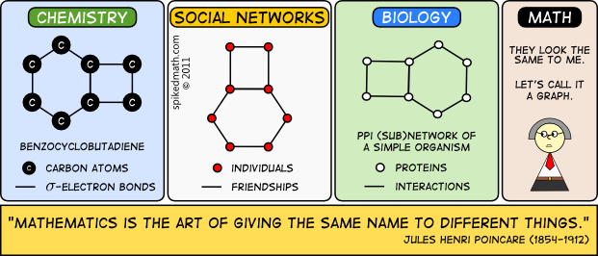
Graph Theory is the study of such visual models that shows the connections and relationships between different objects.

Slide 74
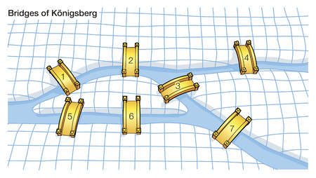
Leonhard Euler (1707-1783) published a paper to solve ancient “Seven Bridges of Konigsberg” problem in 1736. That’s when Graph Theory, as we know today, was born.
Seven Bridges of Konigsberg puzzle: Starting from a point on land, walk through all the seven bridges exactly once and return to the starting point.

Slide 75
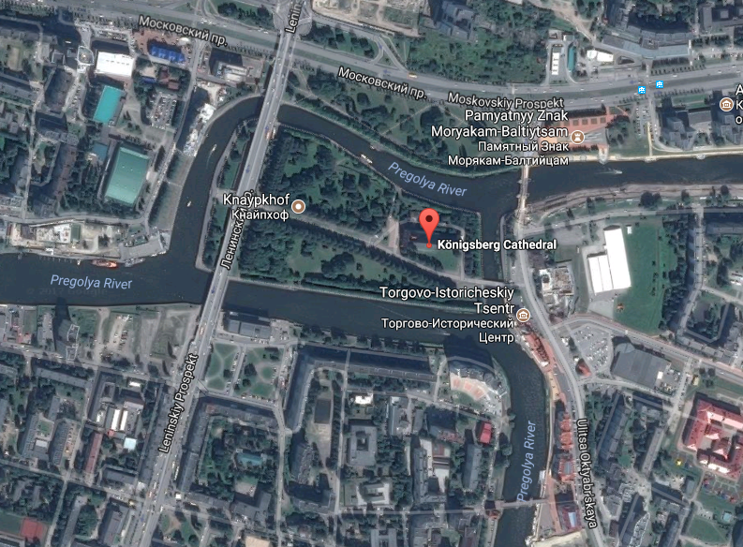

Slide 76
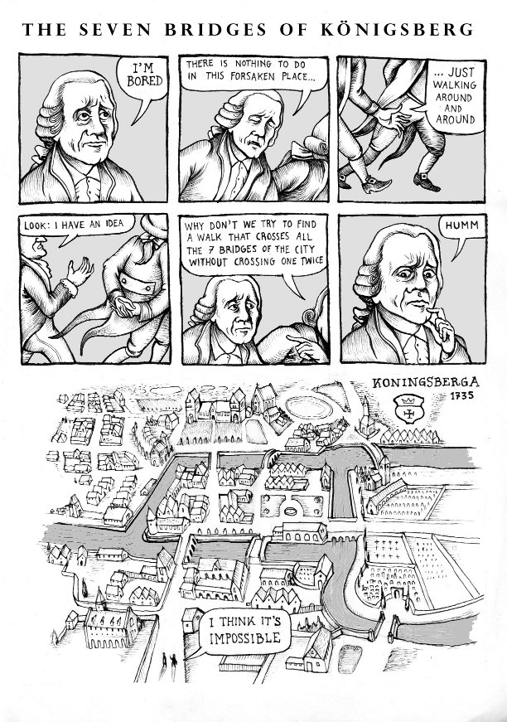
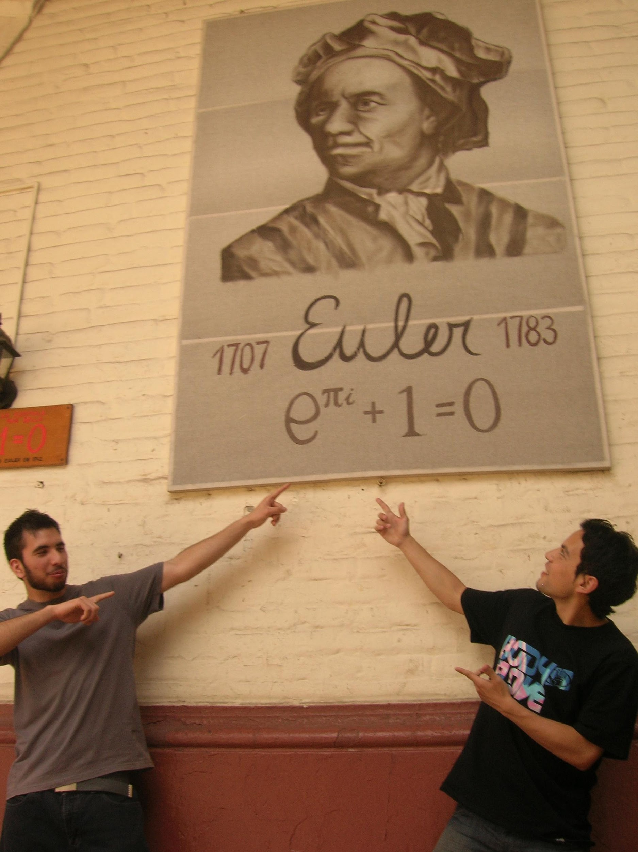

Slide 77
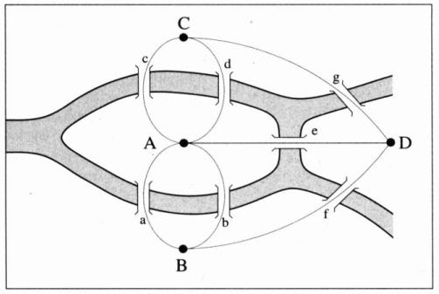
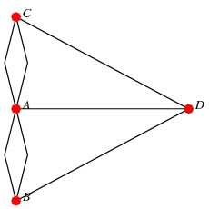
Graph Theory
Seven Bridges of Konigsberg problem solved by Euler

Slide 78
History of Graph Theory:
1736: Leonhard Euler wrote a paper to prove that the “7 bridges of Konigsberg” does not have a solution.
1847: G.R. Kirchhoff developed graph theory for the applications in electrical networks.
1850: A. De Morgan mentioned the four-color problem in a discussion.
1857: A. Cayley developed the theory to enumerate the isomers of saturated hydrocarbons.
1859: W.R. Hamilton invented a puzzle, which essentially asks to find a circuit (now known as Hamiltonian circuit) in a graph.
1936: D. Konig wrote the first book on Graph Theory.

Slide 79
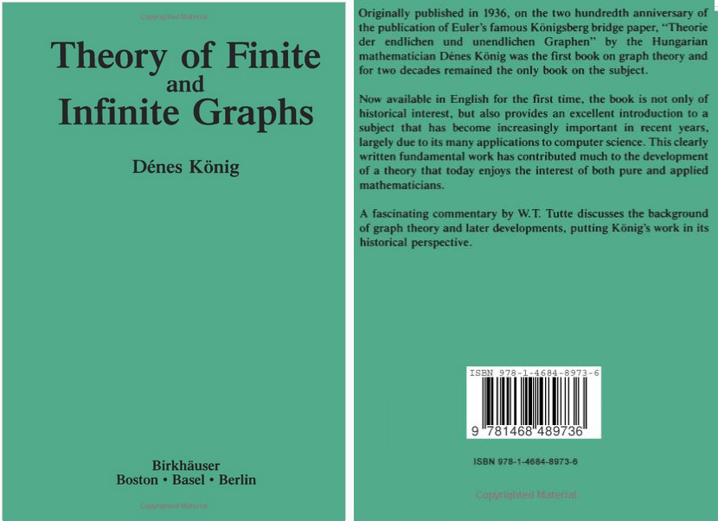

Slide 80
Graph Theory
What is a graph?
A graph (aka linear graph) G = (V, E) consists of a nonempty set of objects V = {v₁, v₂, …} called vertices, and another set E = {e₁, e₂, …} called edges, such that each edge e_{k} is identified with an unordered pair (v_{i}, v_{j}) of vertices.
A graph is discrete structure used to model a discrete set of objects which has pairwise relations between the objects.
Graphs are effective tools to study complex set of interconnected points. Graphs are not to be confused with bar charts, pie charts which often collectively called as graphs.

Slide 81
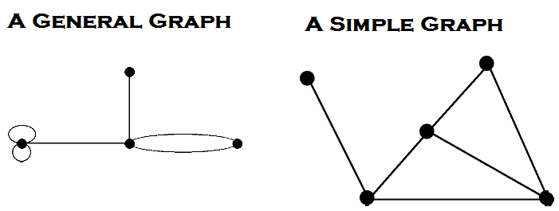
Vertices (aka Nodes, Points, Junctions)
Edges (aka Links, Branches, Lines, Arcs)
Endpoints of an edge belongs to the set of vertices
Adjacent vertices (shares a common edge)
Parallel edges (multiple edges between two vertices)
Self-loops (avoid using the term “loop” for this)
Simple graph (has neither self-loops nor parallel edges)
Multigraphs (parallel edges are allowed)
Pseudographs (parallel edges and self-loops are allowed)

Slide 82
Examples:
A simple graph: Facebook friend-connections among the students of this class. (No self-loops and no parallel edges)
A non-simple graph: Web graph
Graph of web pages with links where webpages are vertices and hyperlinks pointing to webpages are edges of the graph. A webpage may have link to the same page and a web page to point to some other web page multiple times. Google’s Pagerank algorithm uses a web-graph model.

Slide 83
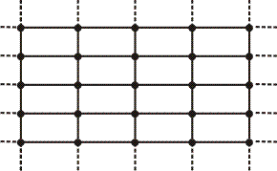
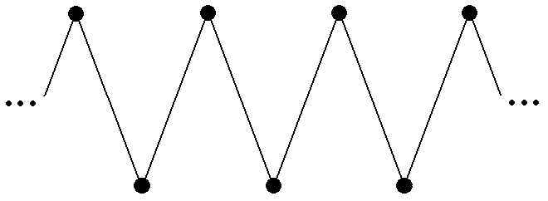
Infinite graphs: (number of vertices are infinite)

Slide 84
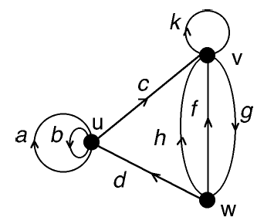
Directed and Undirected Graphs:
Eg: Facebook friend-connections among the students of this class is an undirected graph. (A friend-connection is always bidirectional)
Digraph: A directed graph often called as a digraph.
Arc: A directed edge is often called as an arc.
Eg: Twitter (or Google+) follower-following connections among the students of this class. If person A is following person B, a directed edge would be drawn from vertex A to vertex B. Person B may or may not follow person A.

Slide 85
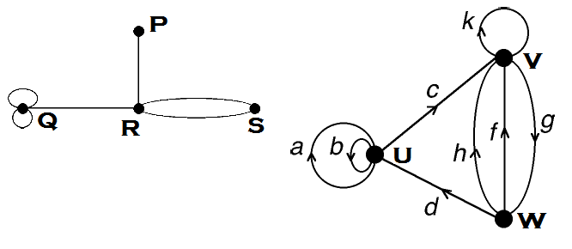
Degree (aka valence) of a vertex v is the number of edge-ends incident on v.
A self-loop contributes two to the degree of a vertex.
In a digraph, Degree of a vertex = Out-degree of the vertex + In-degree of the vertex.
A pendant vertex is a vertex of degree exactly 1.
An isolated vertex is a vertex of degree exactly 0.
A null graph is a graph without edges.

Slide 86
Theorem: The sum of the degrees in a graph equals twice the number of edges.
Corollary: The number of vertices of odd degree in a graph is always even.
The above theorem is aka The Handshaking Theorem because of the following analogy. The sum, over the set of people at a party, of the number of people a person has shaken hands with, is even.
Theorem: In a simple graph with at least two vertices, there would be two vertices with the same degree.

Slide 87
Example: Friend-connections among the students of this class.
Sum of the number of friend-connections of each student of this class is even.
There are even number of students having odd number of friend-connections.
There are two students having same number of friend-connections.

Slide 88
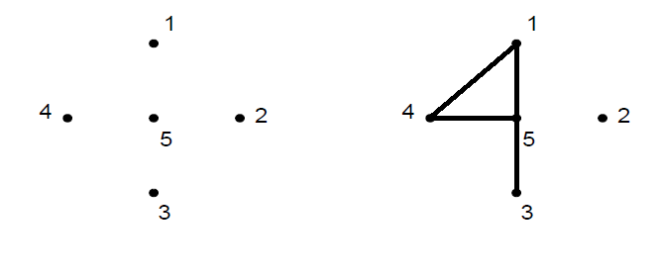
Isolated vertex: All in the 1st graph and vertex 2 in the 2nd.
Pendant vertex: Vertex 3 in the 2nd graph.
Null graph: First graph

Slide 89
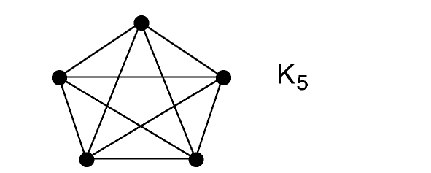
Special Graphs:
A Complete Graph is a simple graph such that every pair of vertices is joined by an edge.
The complete graph with n vertices is denoted as K_{n}.
Q: How many edges does a complete graph K_{n} has?

Slide 90
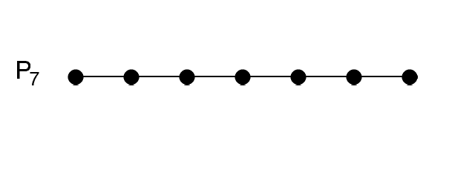
Special Graphs:
A Path Graph has vertices v₁, v₂, …, v_{n} and edges e₁, e₂, …, e_{n-1}, such that edge e_{k} joins vertices v_{k} and v_{k+1}.
The path graph with n vertices is denoted as P_{n}.
Q: How many edges does a path graph P_{n} has?

Slide 91
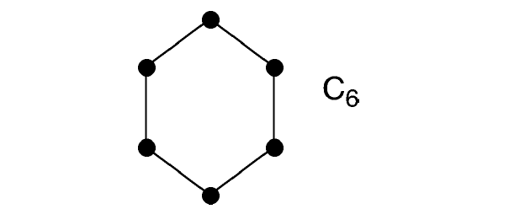
Special Graphs:
A Cycle Graph has vertices v₀, v₁, …, v_{n-1} and edges e₀, e₁, …, e_{n-1}, such that edge e_{k} joins vertices v_{k} and v_{k+1 (mod n)}.
The cycle graph with n vertices is denoted as C_{n}.
Q: How many edges does a cycle graph C_{n} has?

Slide 92
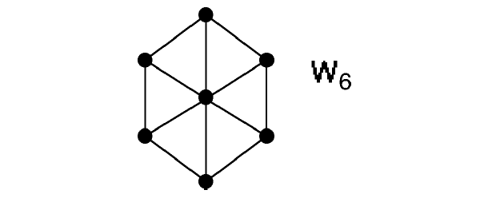
Special Graphs:
A Wheel Graph has a hub vertex joined to every other vertex and a cycle through all the other vertices.
The wheel graph whose rim is an n-cycle is denoted as W_{n}.
Q: How many edges does a wheel graph W_{n} has?

Slide 93
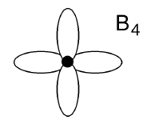
Special Graphs:
A bouquet is a graph with only one vertex.
The bouquet on n edges is denoted by B_{n}.

Slide 94
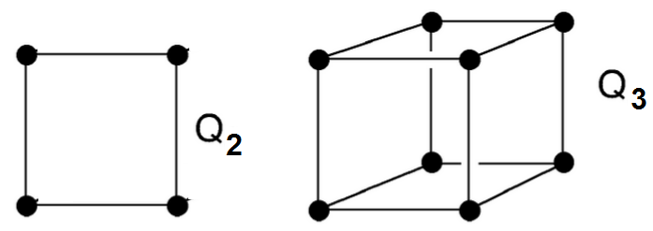
Special Graphs:
The cube graph of dimension n, denoted by Q_{n}, is an n-dimensional cube where each corner is a vertex and each edge of the figure is an edge of the graph.

Slide 95
Regular Graphs:
A graph (not just a simple graph) is regular if every vertex has the same degree.
Are the following graphs are regular?
A simple graph
A complete graph K_{n}
A path graph P_{n}
A cycle graph C_{n}
A cube graph Q_{n}
A bouquet graph B_{n}
A wheel graph W_{n}
A null graph

Slide 96
Regular Graphs:
A graph (not just a simple graph) is regular if every vertex has the same degree.
The following graphs are regular:
Not all simple graphs are regular.
The complete graph K_{n} is regular of degree n-1.
A cycle graph is regular of degree 2.
The cube graph Q_{n} is regular of degree n.
The bouquet graph B_{n} is regular of degree 2n.
The wheel graph W₃ is regular. It is isomorphic to complete graph K₄. W_{n} with n>3 are not regular graphs.
All null graphs are regular of degree 0.

Slide 97
Path in a graph (including non-simple graphs):
Let n be a nonnegative integer and G a graph. A path of length n from vertices u to v in G is a sequence of edges e₁, e₂, …, e_{n} of G such that e₁ is associated with (x₀, x₁), e₂ with (x₁, x₂) and so on, with e_{n} associated with (x_{n-1}, x_{n}), where x₀ = u and x_{n} = v.
When there are no multiple edges in the graph (non-multigraph), the path is denoted by its vertex sequence x₀, x₁, …, x_{n}.
A path of length greater than zero that begins and ends at the same vertex is called a circuit (aka cycle).
A path or circuit is called simple if it does not contain the same edge more than once.

Slide 98
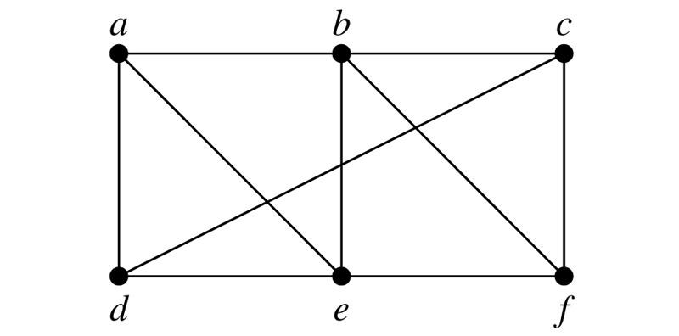
<a, b, e, f> simple path of length 3
<a, b, e, f, b, c> simple path of length 5
<a, b, e, b, c> non-simple path of length 4
<a, b, d> not a valid path because (b,d) is not an edge
<a, e, d, a> simple circuit of length 3
<a, e, d, e, d, a> non-simple circuit of length 5
<a, e, b, f, e, d, a> ??
<a, b, c, b> ??

Slide 99
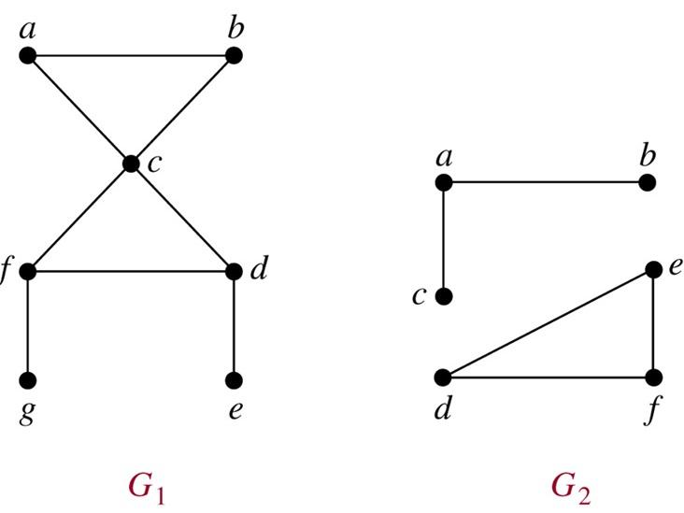
An undirected graph is called connected if there is a path between every pair of distinct vertices of the graph.
Theorem: There is a simple path between every pair of distinct vertices of a connected undirected graph.
Graph G₁ is connected
and G₂ is not.
Every connected
graph with n
vertices has at least
n-1 edges.

Slide 100
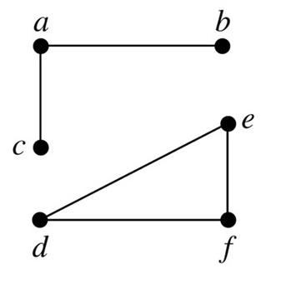
A connected component (or just component) of a graph G is a connected subgraph of G that is not a proper subgraph of another connected subgraph of G.
The following graph has two components.

Slide 101
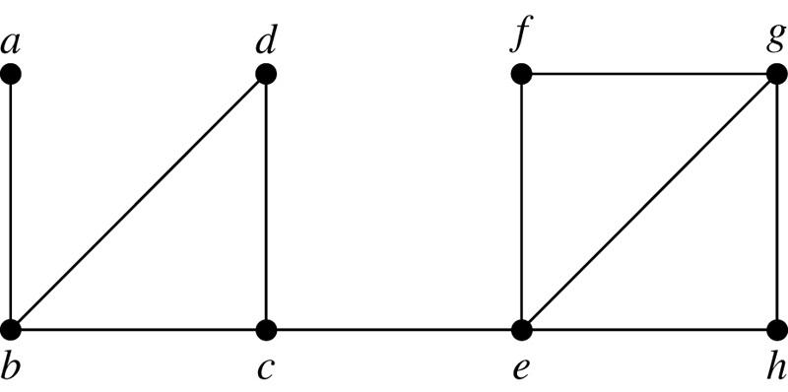
Cut vertices (aka articulation points):
Vertices that when removed along with incidence edges, produces a subgraph with more connected components than the original graph.
b, c, and e are the only cut vertices in the following graph.

Slide 102
Cut edges (aka bridges):
Edges that when removed, produces a subgraph with more connected components than the original graph.
(c,e) and (a,b) the only cut edges in the following graph.

Slide 103
Cut set:
A set of edges that when removed, produces a subgraph with more connected components than the original graph, provided removal of no proper subset of these edges disconnects G.
{(c,e)}, {(a,b)}, and {(b,d), (b,c)} are some of the cut sets in the following graph.

Slide 104
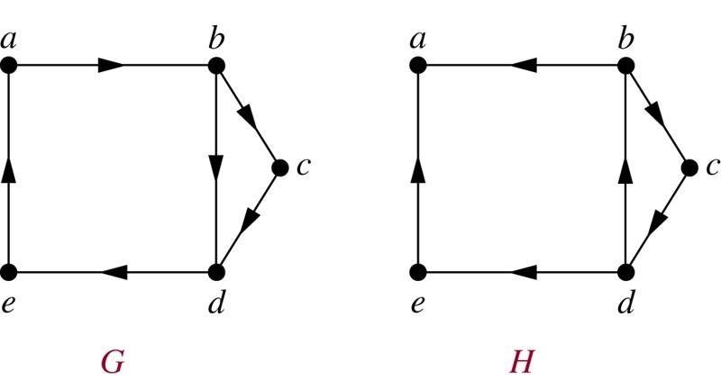
A directed graph is strongly connected if there is a path from a to b and from b to a whenever a and b are vertices in the graph. Graph G shown below is a strongly connected graph.
A directed graph is weakly connected if there is a path between every two vertices in the underlying undirected graph. Graph H shown below is a weakly connected graph, but not a strongly connected graph.

Slide 105
Strongly connected components:
The subgraphs of a directed graph G that are strongly connected but not contained in larger strongly connected subgraphs, that is, the maximal strongly connected subgraphs, are called the strongly connected components of G. In the graphs shown below, graph H has three strongly connected components with the vertices {a}, {e} and {b, c, d}.

Slide 106
Euler Circuit/Path in a connected multigraph:
A simple circuit/path containing every edge of the graph.
Seven Bridges of Konigsberg: Starting from a point on land, walk through all the seven bridges exactly once and return to the starting point. It essentially means, is the graph shown below has an Euler circuit?

Slide 107
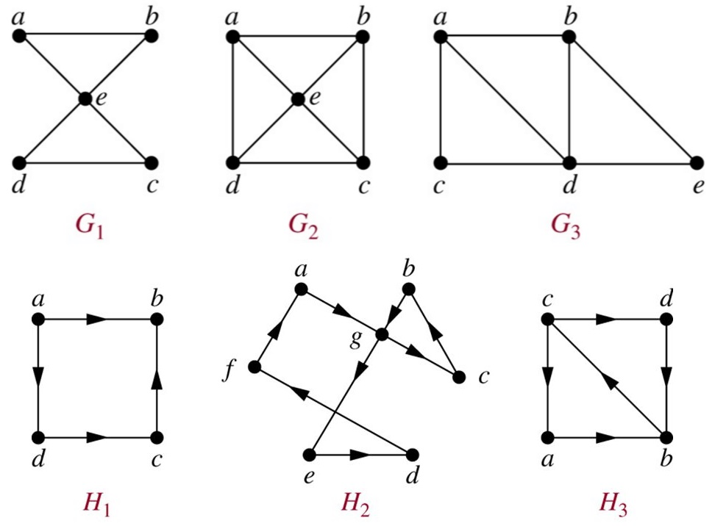
Euler Circuit/Path in a connected multigraph:
A simple circuit/path containing every edge of the graph.

Slide 108
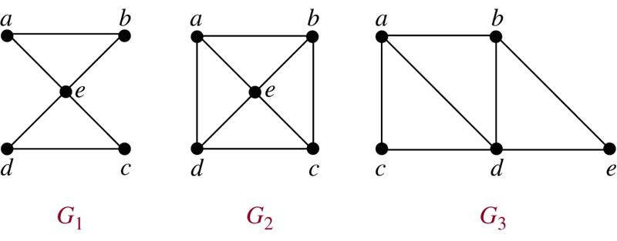
Euler Circuit/Path in a connected multigraph:
A simple circuit/path containing every edge of the graph.
G₁ has an Euler circuit.
G₂ does not have any Euler circuits or Euler paths.
G₃ has an Euler path, but not an Euler circuit.

Slide 109
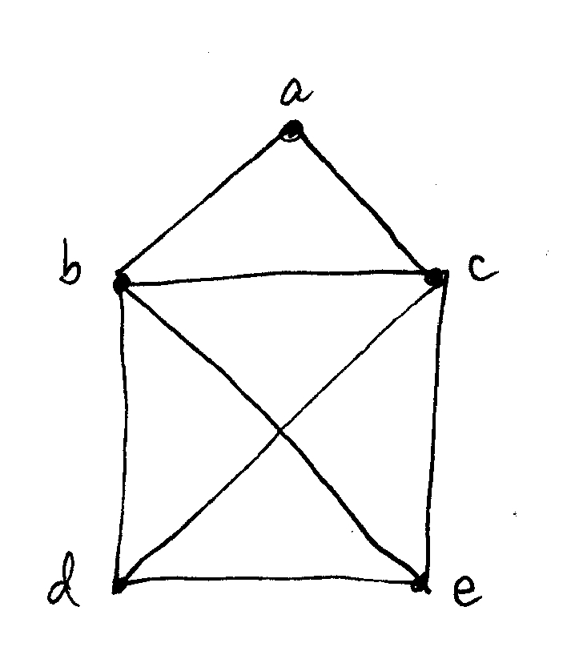
Draw a picture in continuous motion without lifting a pen/pencil so that no part of the picture is retraced.
It essentially means, draw the graph which has an Euler circuit or an Euler path.

Slide 110
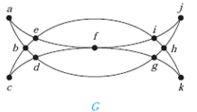
Draw a picture in continuous motion without lifting a pen/pencil so that no part of the picture is retraced.
It essentially means, draw the graph which has an Euler circuit or an Euler path.

Slide 111
Theorem:
A connected multigraph with at least two vertices has an Euler circuit if and only if each of its vertices has even degree.
To prove:
“It has an Euler circuit → each of its vertices has even degree”
OR
“There is vertex of odd degree → It does not have an Euler ckt”
AND (its converse statement)
“Each of its vertices has even degree → It has an Euler circuit”.

Slide 112
Euler Circuit in a connected multigraph:
Necessary and Sufficient Conditions:
Has an Euler circuit → necessary condition
Sufficient condition → has an Euler circuit

Slide 113
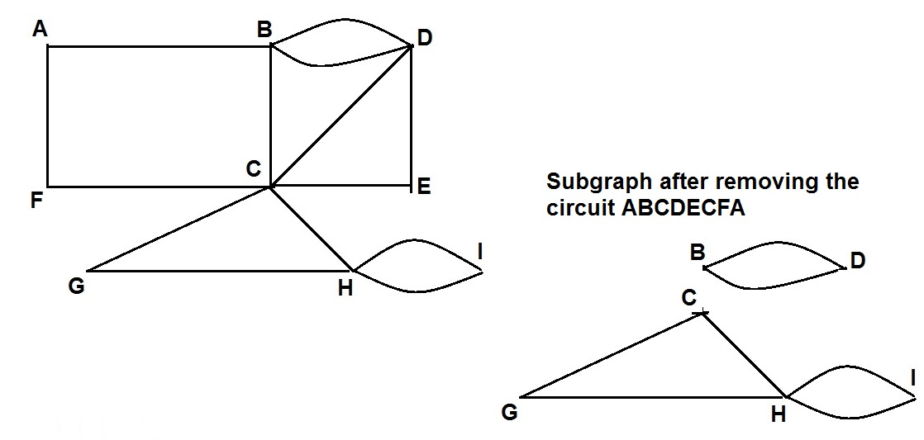
Euler Circuit/Path in a connected multigraph:
Necessary and Sufficient Conditions:
Has an Euler circuit → all vertices have even degree
All vertices have even degree → has an Euler circuit

Slide 114
Theorem:
A connected multigraph with at least two vertices has an Euler circuit if and only if each of its vertices has even degree.
To prove:
“It has an Euler circuit → each of its vertices has even degree” AND
“Each of its vertices has even degree → It has an Euler circuit”.
Theorem:
A connected multigraph has an Euler path but not an Euler circuit if and only if it has exactly two vertices of odd degree.
Proof: Similar to the above theorem.

Slide 115
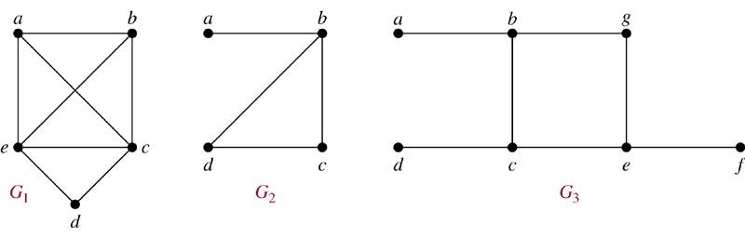
Hamilton Circuit/Path in a Graph:
A simple circuit/path passing through every vertex of the graph exactly once.
G₁ has a Hamiltonian circuit: abcdea
G₂ has a Hamiltonian path, but not circuit: abcd
G₃ has neither Hamiltonian path nor Hamiltonian circuit.

Slide 116
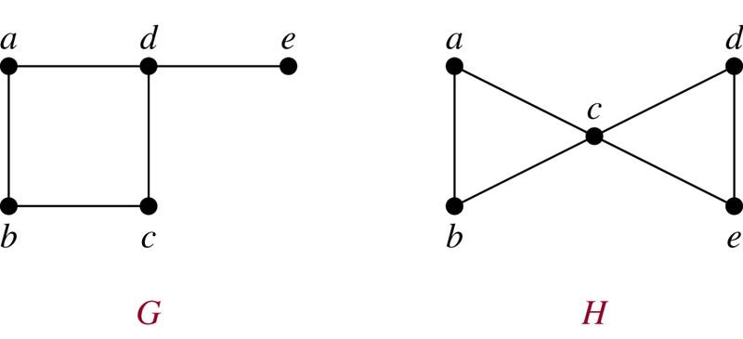
G has a Hamiltonian path, but not circuit: edabc
H has Hamiltonian path but not Hamiltonian circuit.

Slide 117
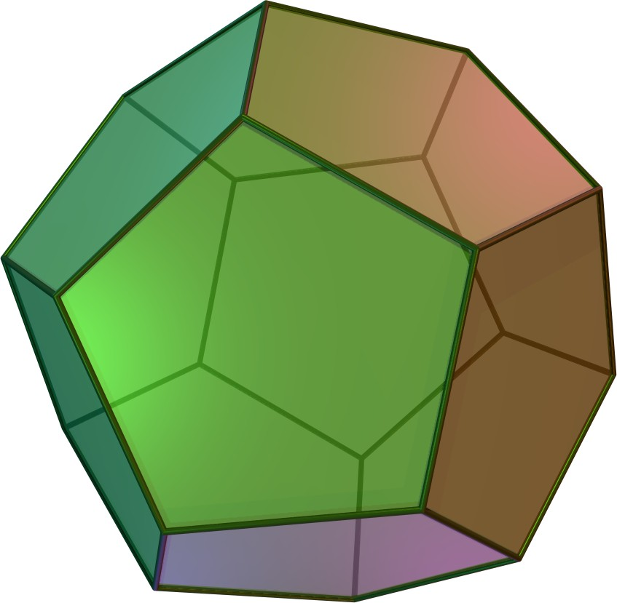
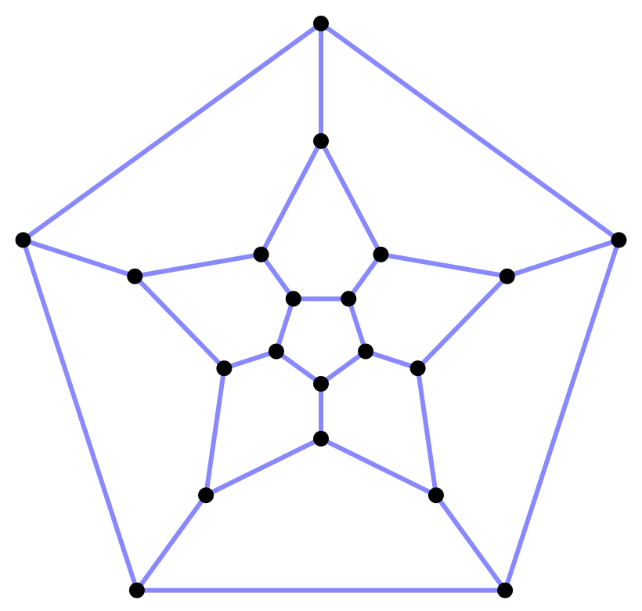
Icosian Puzzle: Invented by Sir William Rowan Hamilton
It’s a wooden dodecahedron with a peg at each vertex and string is given. The puzzle is to start with a vertex, pass through every vertex exactly once and end at the starting vertex.

Slide 118
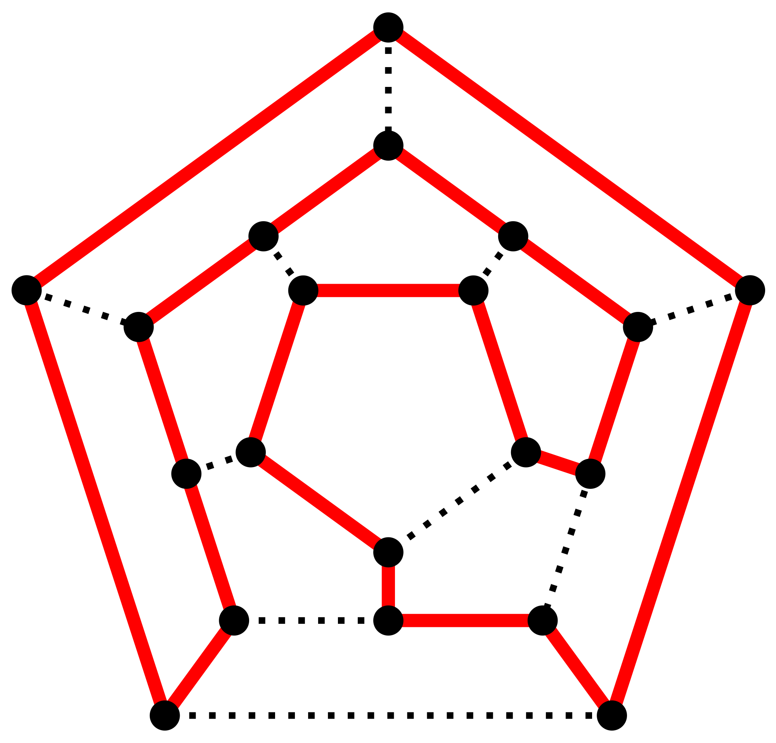
Icosian Puzzle: A solution
* Abhimanyu finds an Hamilton path, but Arjuna can find an Hamilton circuit.

Slide 119
Hamilton Circuits: Necessary conditions
A graph has an Hamiltonian circuit only if
Graph has at least n edges, where n = |V|.
Graph has no pendant vertices.
Graph has no cut vertex.
…
Any vertex with degree two will have both the edges in any Hamilton Circuits.

Slide 120
Hamilton Circuits: Sufficient Conditions
A graph has an Hamiltonian circuit if
it is a cycle graph C_{n}
it is a wheel graph W_{n}
it is a complete graph K_{n} where n >= 3.
…

Slide 121
Hamilton Circuits: Sufficient Conditions
No useful necessary and sufficient conditions for the existence of Hamilton circuits are known, and hence the best known algorithms for finding an Hamilton circuit have exponential worst-case time complexity.
The more edges a graph has, the more likely it is to have a Hamilton circuit.
K_{n} graph with n ≥ 3, has a Hamilton Circuit.
Adding edges to a graph with a Hamilton circuit does not take away the Hamilton circuit it already has.

Slide 122
Hamilton Circuits: Sufficient Conditions
K_{n} graph where n ≥ 3, has a Hamilton Circuit.
Diracs’s Theorem: (covers above condition)
If G is a simple graph having n vertices with n ≥ 3 such that the degree of every vertex in G is at least n/2, then G has a Hamilton Circuit.
Ore’s Theorem: (covers above theorem)
If G is a simple graph having n vertices with n ≥ 3 such that deg(u) + deg(v) ≥ n for every pair of nonadjacent vertices u and v in G, then G has a Hamilton Circuit.
Bondy-Chvatal theorem (covers above theorem).

Slide 123
< End of
Mathematical Induction,
Recursion and Recurrence Relations and graphs
/>

